Slide 1

Advanced course
Lesson 13
Advanced course（4）
Rocker control
YahBoom Croco:Kit tutorial

Slide 2
Advanced course
Content
Part1
Part 2
Part3
Part 4
Part 5
Learning goals
Preparation
Connection
Search for blocks
Combine blocks
YahBoom Croco:Kit tutorial

Slide 3
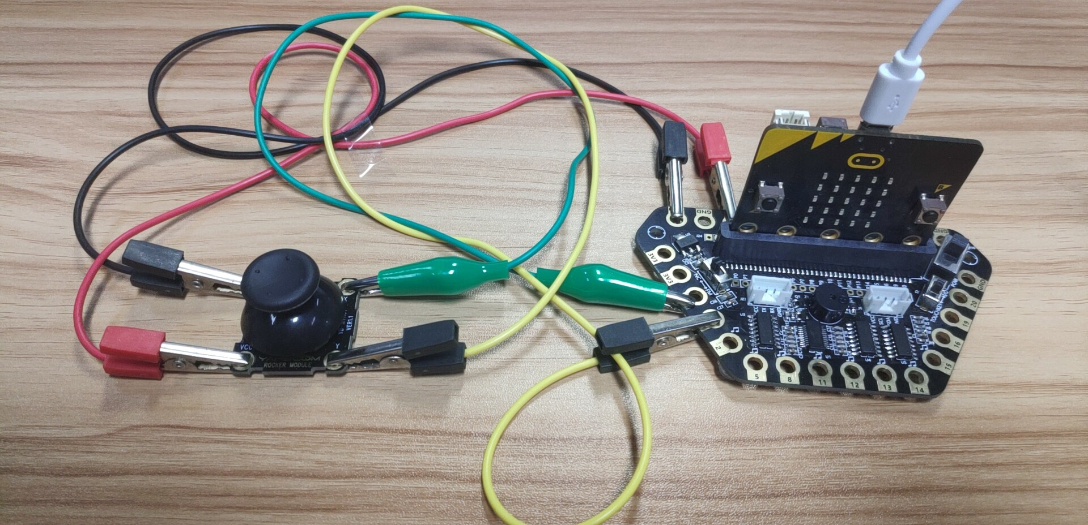
Advanced course
Part 1
Learning goals
After downloading the program, we can see a “Heart” on the Micro:bit LED dot matrix. When the rocker module is up, the up arrow is displayed on the LED dot matrix, When the rocker module is down, the down arrow is displayed on the LED dot matrix,
When the rocker module is left, the left arrow is displayed on the LED dot matrix,
When the rocker module is right, the right arrow is displayed on the LED dot matrix.
YahBoom Croco:Kit tutorial

Slide 4
Advanced course
Part 2
Hardware:
● 1 X Micro: bit Board
● 1 X Micro USB Cable
● 1 X Diamond breakout
● 1 X Rocker module
● 4 X Alligator clip
● 1 X PC
Preparation
Mode 1 online programming: First, we need to connect the micro:bit to the computer by USB cable. The computer will pop up a USB flash drive and click on the URL in the USB flash drive: http://microbit.org/ to enter the programming interface. Add the Yahboom package: https://github.com/lzty634158/Croco-Kit to program.
Mode 2 offline programming: We need to open the offline programming software. After the installation is complete, enter the programming interface, click【New Project】, add Yahboom package: https://github.com/lzty634158/Croco-Kit , you can program.
YahBoom Croco:Kit tutorial

Slide 5
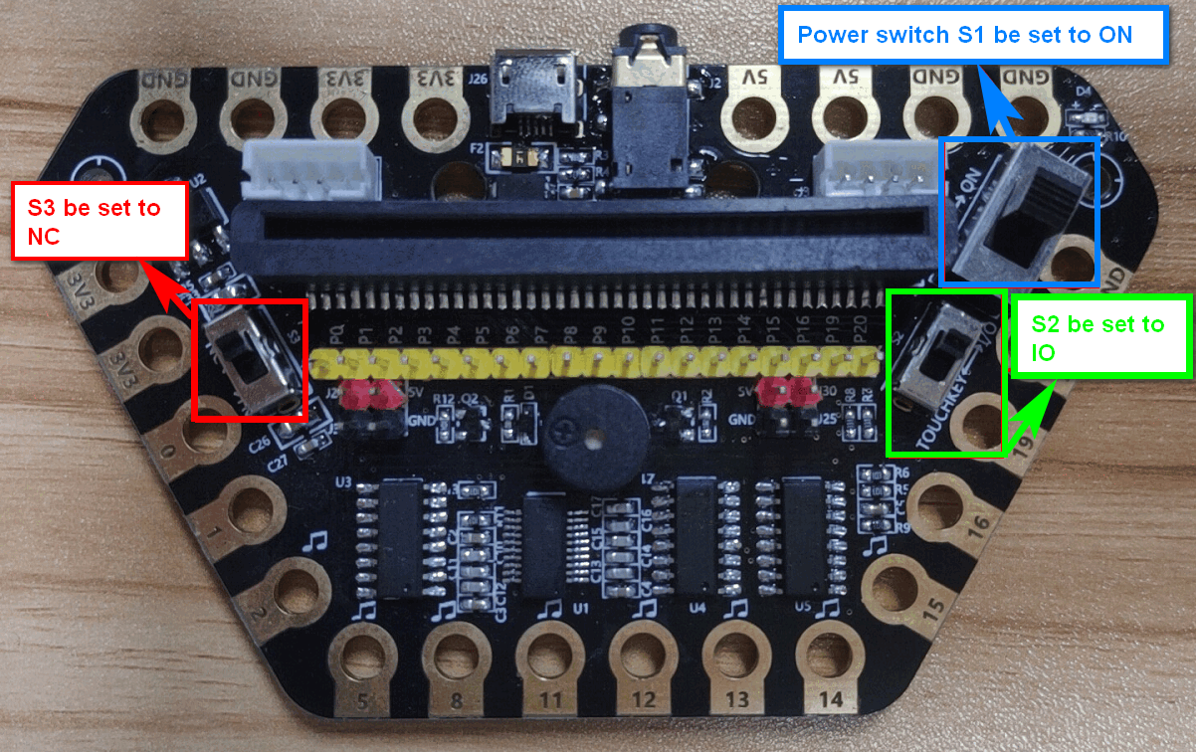
Advanced course
Part 2
Preparation
! ! !Note: S1 be set to the ON, S2 be set to the IO, and S3 to the NC.
YahBoom Croco:Kit tutorial

Slide 6
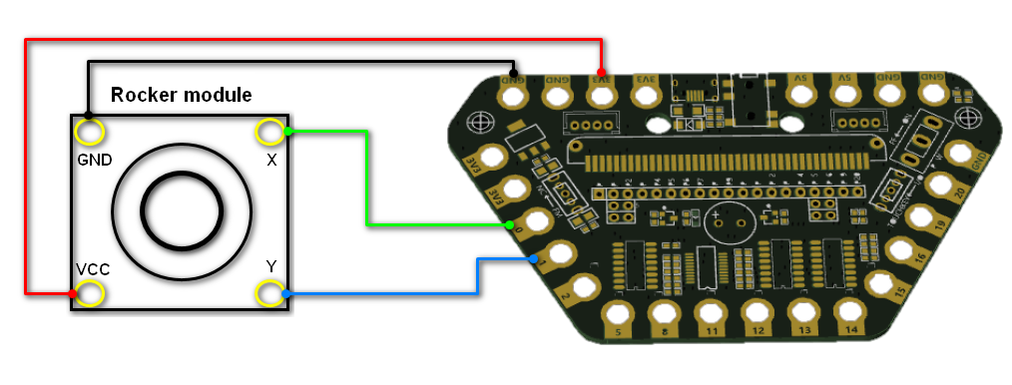
Advanced course
Part 3
Expansion board | Rocker module
P0 | X
P1 | Y
3.3V | VCC
GND | GND
Connection
YahBoom Croco:Kit tutorial

Slide 7
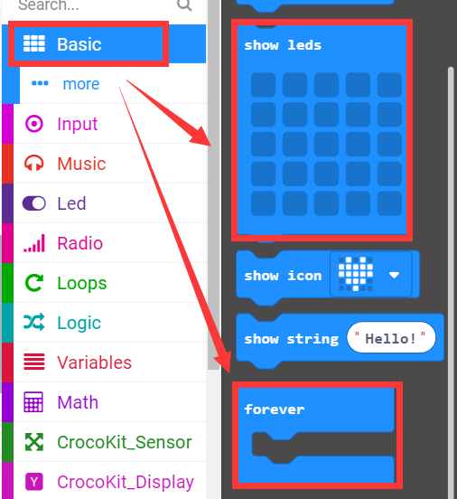
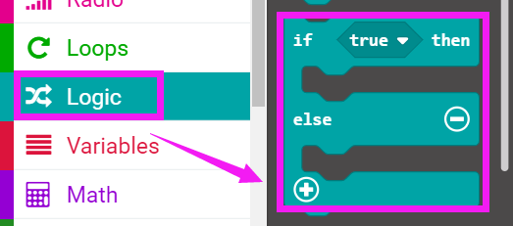
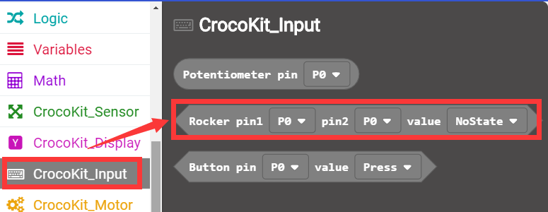
Advanced course
Part 4
Search for blocks
YahBoom Croco:Kit tutorial

Slide 8
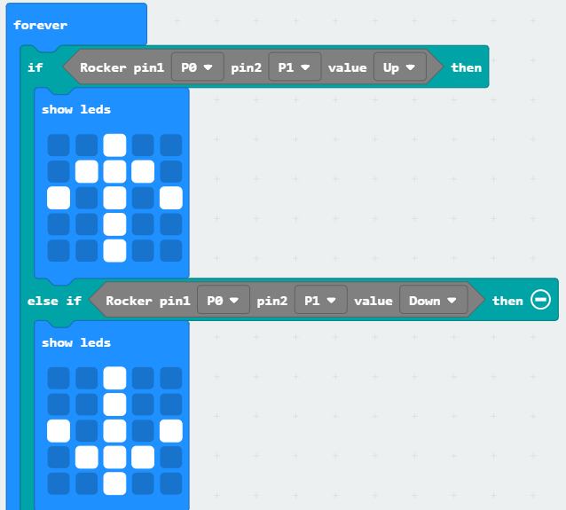
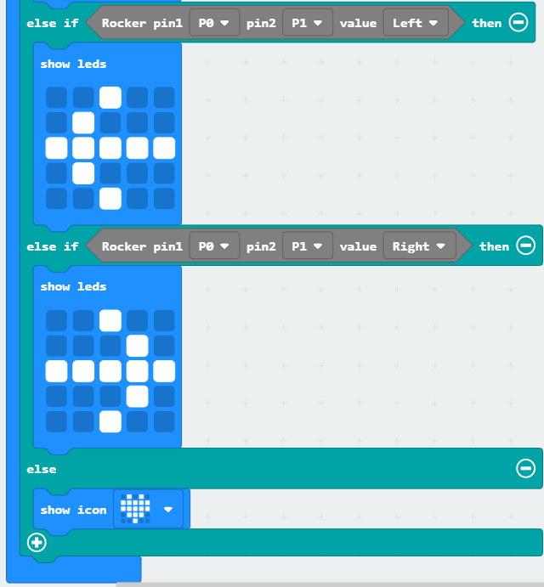
Advanced course
Part 5
Combine blocks
YahBoom Croco:Kit tutorial

Slide 9
Advanced course
Thank you ！
Powered by YahBoom
YahBoom Croco:Kit tutorial

